Slide 1

UNIQUE NODES OF BINARY SEARCH TREE
SUBMITTED BY:
M.P.Harika-192211999
T.Mahidhar-192211243
S.Hasrith-192211470

Slide 2

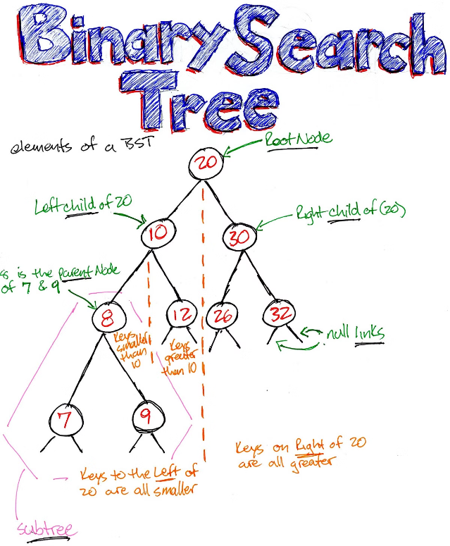
Introduction to Binary Search Trees (BSTs)
Binary Search Trees (BSTs) are a fundamental data structure in computer science, used to efficiently store and retrieve data. They are hierarchical tree-like structures where each node has a unique value that is greater than all values in its left subtree and less than all values in its right subtree.

Slide 3

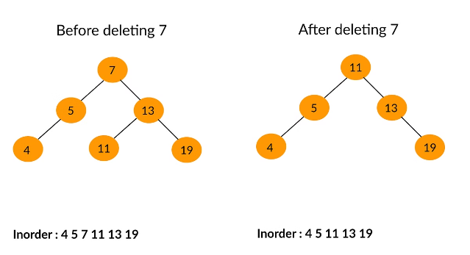
Definition of a Unique Node
In a Binary Search Tree, a unique node is a node whose value is not present anywhere else in the tree. These nodes play a crucial role in the efficient organization and search capabilities of BSTs, as they help maintain the tree's structure and ensure data integrity.

Slide 4


Identifying Unique Nodes in a BST
1
Recursive Traversal
2
Frequency Mapping
3
Sorted Comparison
Traverse the tree recursively, checking if the current node's value is unique compared to all other nodes in the tree.
Create a data structure to keep track of the frequency of each value in the tree, then identify the nodes with a frequency of 1 as unique.
Sort the values in the tree and compare adjacent values to find any duplicates, marking the unique values accordingly.

Slide 5
Importance of Unique Nodes in BSTs
Efficient Retrieval
Unique Identification
Balanced Structure
Unique nodes allow for faster search and retrieval of data in the tree, as there are no duplicates to consider.
Unique nodes can be used to uniquely identify specific elements in the tree, enabling more precise data management and operations.
Maintaining unique nodes helps preserve the balanced structure of the BST, ensuring optimal performance for operations like insertion and deletion.

Slide 6




Algorithms for Finding Unique Nodes
Traversal-based
Perform a depth-first or breadth-first traversal of the tree, keeping track of node values and their frequencies.
Hashing
Use a hash table to store the values of the tree, then identify the unique nodes based on their frequency in the hash table.
Sorting and Comparison
Sort the tree's values and compare adjacent elements to find unique nodes based on their relative positions.

Slide 7

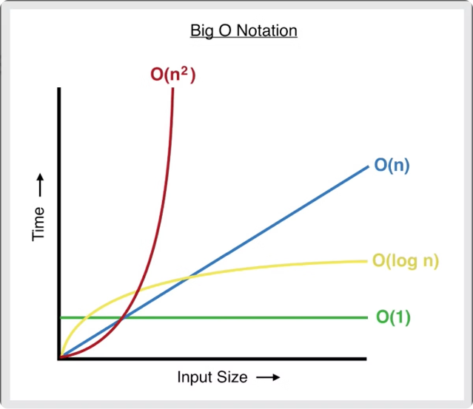
Time Complexity of Unique Node Identification
Traversal-based
O(n)
Hashing
O(n)
Sorting and Comparison
O(n log n)

Slide 8





Practical Applications of Unique Nodes
Database Indexing
Decision Tree Models
Unique nodes can be used to create efficient indexes for database management systems.
Unique nodes in decision trees help improve the accuracy and interpretability of machine learning models.
File System Organization
Graph Algorithms
Unique nodes can be leveraged to maintain a well-structured file system with no duplicates.
Identifying unique nodes is crucial for various graph-based algorithms, such as finding connected components.

Slide 9

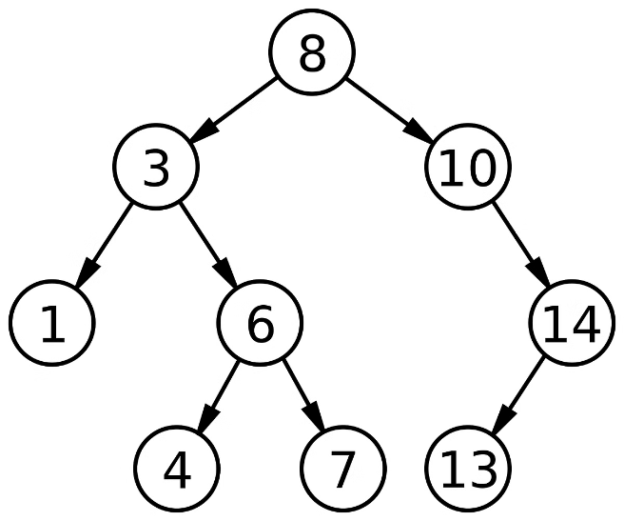
Conclusion and Key Takeaways
Unique Nodes are Crucial
Varied Identification Approaches
Unique nodes in Binary Search Trees play a vital role in maintaining the tree's structure, enabling efficient data storage and retrieval.0
There are multiple algorithms for identifying unique nodes, each with its own time complexity and trade-offs.
Diverse Applications
Continued Importance
Unique nodes have numerous practical applications, from database indexing to graph algorithms and beyond.
As data structures and algorithms continue to evolve, the importance of unique nodes in BSTs remains a fundamental concept in computer science.

